Slide 1
TANTALUM COTS-Plus
An Alternate Grade Bulk Capacitor For LEO Flight Platforms
Slavomir Pala | Ron Demcko

Slide 2
TANTALUM CAPACITOR CONSTRUCTION
/ Polymer
Cathode is Manganese Dioxide (MnO₂) or Conductive polymer
Anode Consist of Particles of Pure Tantalum Powder
Anode is Sintered into a Pellet and a Thin Layer of Ta₂O₅ Dielectric is Formed
Additional Layers of Carbon and Silver are Added to Ensure a Solid Connection
Tantalum Wired Embedded at One End of Anode, is Welded to One Termination of the Lead Frame.
Cathode is Connected to Other Lead Frame With Conductive Epoxy
Structure is Then Over-Molded

Slide 3
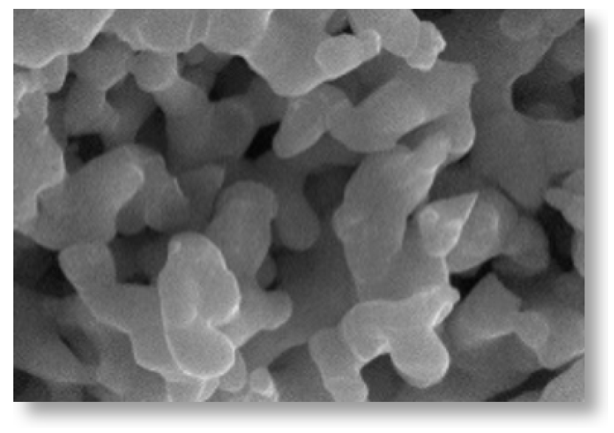
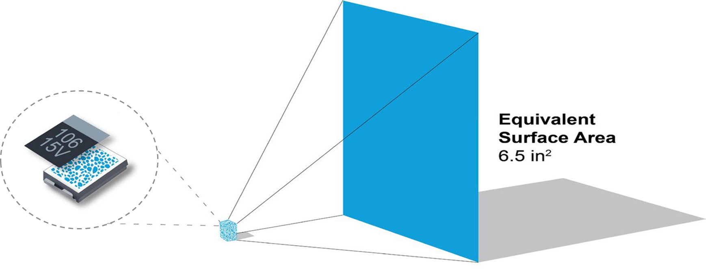
TANTALUM CAPACITOR CONSTRUCTION: SURFACE AREA
Larger Surface Area is Contributed to Sponge-Like Structure, Allowing Very High Capacitance in Smaller Package
Equivalent Surfice Area:
40cm²
TBJ A case
Case size: 3.2 × 1.6 × 1.6 mm

Slide 4
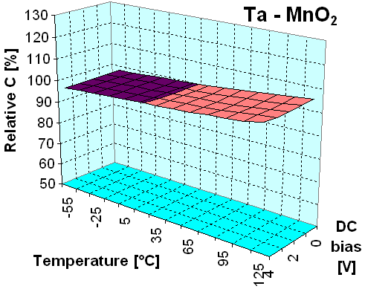
TANTALUM CAPACITOR APPLICATION FEATURES
 | Ta- MnO₂ | Ta-Polymer
Benefits | Unlimited lifetime Lower profile (height) for height restrictive apps. High Long term reliability Stable electrical parameters Self-healing mechanism Wide temperature range (up to 230°C) Volumetric efficiency Low DCL Clear filtering Mechanically robust | Low ESR=high ripple High energy J/cc High voltage up to 125V Surge resistant 10% or 20% derating High reliability -55°C / +105 / +150°C Stable Cap V/T Low profile DCL <0.1CV Mechanically robust Clear filtering (no noise)
Points to check | Limited to lower voltage (50VR max) Sensitive to current surge Derating rules Reverse voltage Polarisation | Moisture sensitive MSL 3-5 Aging (impact ESR/Cap) Polarisation
Hermetic polymer comes with MSL 1

Slide 5
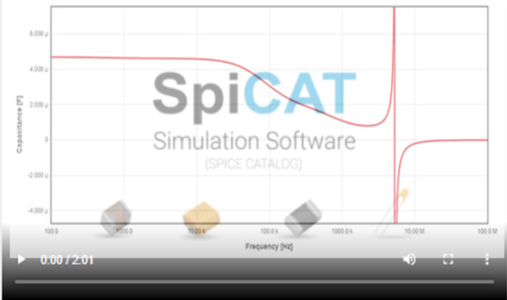
TANTALUM CAPACITOR APPLICATION FEATURES
Why Ta-Electrolyte | Application | Benefites
High reliability High stable CV in multiple case size and range offerings Physically size efficient bulk capacitor option Ultra-low leakage tantalum Stable capacitance with temp, time and voltage Improved RF characteristic over aluminum capacitors | Board level power conversion/distribution Time of flight module capacitor RF amplifier bias bank Power buffer for laser optic Low noise amplifier filtering Reduction of noise in RF receiver Wake-up capacitor | Improved bulk capacitance stability Stable capacitance with temp, time and voltage Increased energy density Case size mechanical stability Noise free characteristic Almost infinite charge/discharge (polymer aging)

Slide 6
TANTALUM CAPACITORS PERFORMANCE GRADE
Commercial Off the Shelf (COTS-Plus) Offer:
Smaller Size
Higher Capacitance
Faster Lead Times
Additional Specific Testing
Established Reliability (HiRel)
COTS-Plus Established Reliability, Customer Screening Options
CECC / CTC4 European Established Reliability Standards
DLA (DSCC) Drawings Document Standardization of Electronic Components
MIL QPL US Established Reliability, MIL QPL Plant Design Control Full Conformance Standard
Space COTS+ Space Level ESCC ESA QPL
Each Grade in Established Reliability is Intended to Meet Specific Quality Demands
Commercial Reliability
Commercial All Standard Consumer Items
Professional (automotive) Grade Includes Conservative Design & SnPb Options

Slide 7
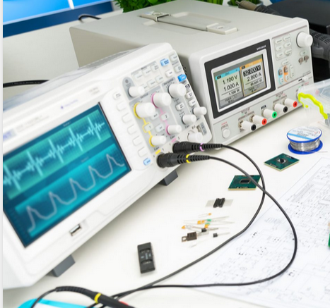
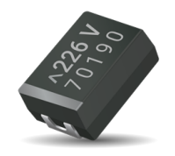
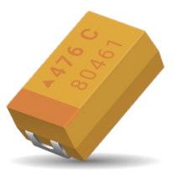
SPACE TESTING & SPECIFICATION
 |  |  | 100% Reflow | Vibration | Shock | 100% Thermal Shock | RTSH | Moisture Resistance | Operating Life | 100% Weibull | 100% Surge Current | 100% Electrical Testing | Visual & Mechanical | Sim Mounting, Rework, Life | Solderability | 100% X-Ray | DPA-1580 | Surge Voltage | Hot DC Leakage | Temperature Stability | Adhesion Shear
Specification |  | Series
COTS-Plus | COTS-Plus | TBJ | 0 |  |  | 0 |  |  |  | 0 | 1 | 0 | 0 3 |  | 1 3 |  |  |  |  | 1 3
Space Level | SRC8000 | TBJ | 0 |  |  | 0 |  |  |  | 0 | 1 | 0 5 | 0 3 | 0 3 | 0 3 | 0 3 |  |  | 0 3 | 0 3
Space Level | SRC9000 | TBJ | 0 | 1 3 | 1 3 | 0 | 1 3 | 1 3 | 0 1 3 4 | 0 | 0 | 0 5 | 0 | 0 3 | 0 3 | 0 | 0 3 | 0 3 | 0 3 | 0 3 | 1 3
MIL-PRF-55365 QPL | T Level | CWR09,11,15, 19,29 | 0 2 | 2 3 |  | 0 2 | 2 3 | 2 3 | 0 2 3 | 0 2 | 0 2 | 0 2 6 | 0 2 |  | 1 2 3 | 0 2 | 0 3 | 2 3 |  | 0 2 3
Space Level | ESCC | TAJ / TES / TCS | 0 | 1 2 | 1 2 | 0 1 |  | 1 2 | 1 2 |  | 0 | 0 5* | 0 |  | 0 3 | 0 1 |  | 0 | 0* | 0 2 | 1 2
Key
0 = Standard Test
1 = Optional Test
2 = Qual and / or Group C
3 = Sample Test
4 = COTS Upscreen 1000 hr @125°C
5 = KAVX Std DCL / ESR / DF / 3 Sigma
6 = DLA Std DCL / ESR / DF / 3 Sigma

Slide 8
TBJ CAPACITORS PERFORMANCE IN LEO SAT
COTS-Plus & SRC8000
Series | Case Size | Approximate Average Weight (g) | ESL (nH)
TBJ | A | 0.029 | 1.8
 | B | 0.068 | 1.8
 | C | 0.166 | 2.2
 | D | 0.290 | 2.4
 | E | 0.512 | 2.5
 | U | 0.738 | 2.4
broadband SRF
~ 100kHz – 5MHz.
477A
337A
L14BB
L14BB
107A
476A
L14BB
L14BB
L14BB
156A

Slide 9
SUMMARY
Ta-MnO₂ & Conductive polymer technology have proven performance and attractive parameters
High processing cores are increasing the need for Lightweight, High performance bulk caps
COTS-Plus spec for MnO₂ and Conductive polymer offer stable design and proven High Volume Processes
Optimized SRC8000 spec enable to offer wider CV range with lower LT and cost to full space range parts
Additional customized Screening can be Applied to COTS-Plus parts

